Slide 1


An Introduction to Green Button
Green Button Download
My Data
Dr. David Wollman Deputy Director, Smart Grid and Cyber-Physical Systems Program Manager, Smart Grid Standards and Research Engineering Laboratory National Institute of Standards and Technology (NIST)

Slide 2

Outline
Introduction
NIST role, in coordination with OSTP, DOE, FERC, and others
Smart Grid Interoperability Panel (SGIP)
Green Button & White House call to action
Green Button Overview
Recent highlights
Value story
Standards foundation and timeline
SGIP Priority Action Plan support
Green Button Technical Details
Energy Usage Information standardization
Green Button file format
Resources and User Communities

Slide 3





US Government Roles in Smart Grid
Federal
Office of Science and Technology
Policy; National Economic Council;
Council on Environmental Quality
Smart Grid Task Force /
National Science &
Technology Council
Smart Grid
Subcommittee
Other Federal
Agencies (EPA, …)
Federal
Energy
Regulatory
Commission
State
FERC – NARUC
Smart Response Collaborative
State Public Utility Commissions
Notes:
3

Slide 4

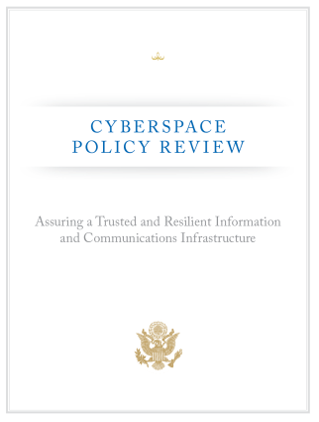


Standards – Key Aspect of US Smart Grid Policy
The Energy Independence and Security Act of 2007 gives NIST “primary responsibility to coordinate development of a framework that includes protocols and model standards for information management to achieve interoperability of smart grid devices and systems…”
The NSTC Subcommittee on Smart Grid Policy: “A Policy Framework for the 21st Century Grid: Enabling Our Secure Energy Future”
OMB/USTR/OSTP January 17, 2012 memo: Principles for Federal Engagement in Standards Activities to Address National Priorities
National Tech Transfer and Advancement Act / OMB A-119 – NIST standards coordination role
Congress directed that the framework be “flexible, uniform, and technology neutral”
Input to DOE, use of NIST-identified standards as criteria for federal Smart Grid Grants
Input to federal (FERC) and state regulators

Slide 5


NIST Smart Grid Interoperability Panel
Public-private partnership created in Nov. 2009
Approx. 750 member organizations, 1900+ participants
Open, public process with international participation
Coordinates and accelerates standards development
Identifies Requirements
Prioritizes standards development programs
Works with over 20 SDOs including IEC, ISO, ITU, IEEE, …
Web-based participation
SGIP Twiki:
http://collaborate.nist.gov/twiki-sggrid/bin/view/SmartGrid/SGIP

Slide 6
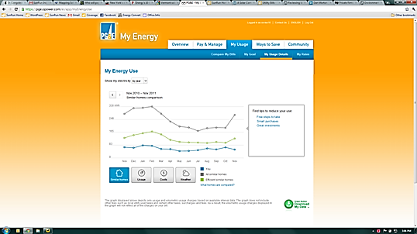
What is Green Button? White House call to action
Common-sense idea that electricity customers should be able to download their own energy usage information in consumer- and computer-friendly format.
Notes:
6

Slide 7
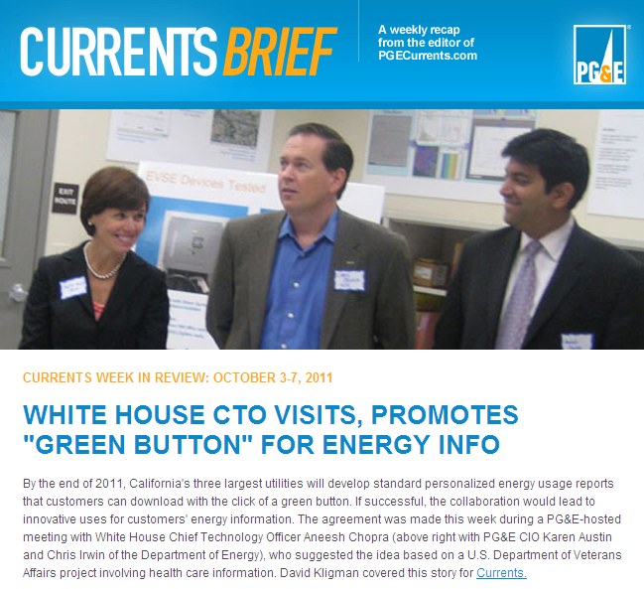
September 2011 – Challenge to Industry January 2012 – Celebrate California launch
As of January 18th, nearly 6 million households and 17 million residents in CA have access to a Green Button.
In conjunction with a recent White House Green Button meeting on March 22, 2012, an additional 9 utilities and many additional vendors committed to implementing and supporting Green Button, increasing the number of households to 27 million that will have Green Button access by the end of 2012.
All 3 CA utilities commit to “green button;” aligns with CPUC rulemaking on privacy, consumer access to energy data, and OIRA “smart disclosure” memo

Slide 8

What is Green Button data good for?
Empower Consumers and Spur Innovation
Insight: entrepreneur-created web portals analyze energy usage and provide actionable tips;
Heating and Cooling: customized heating and cooling activities for savings and comfort;
Education: community and student energy efficiency competitions;
Retrofits: improved decision-support tools to facilitate energy efficiency retrofits;
Verification: measurement of energy efficiency investments;
Real Estate: provide energy costs for tenants and/or new home purchasers; and
Solar: optimize the size and cost-effectiveness of rooftop solar panels.
Source:
Notes:
8

Slide 9
What people are saying…
It may finally give consumers a reason to care about the smart grid.
– SF Chronicle
Solar companies are also eager for consumer data because understanding a homeowner's electricity use is key to the sales process.
– San Jose Mercury News
The project is important because it is a broad-based plan to take energy data and standardize the format of it, open it up (while also providing security) and make it readily available to consumers.
– Gigaom
I'm a big fan of simplicity and open standards to unleash a lot of innovation.…I'm going to reach out to ConEd, the utility in NYC, and find out when they are going to add Green Button support to their consumers data. I hope it is soon.
– Fred Wilson (Venture Capitalist)
Source:
Notes:
9

Slide 10
Green Button Overview
David Wollman, NIST
With acknowledgements to Marty Burns of the EnerNex SGIP administrator team

Slide 11
What is Green Button?
The vision – collaboration and inspiration, using voluntary adoption of industry standards
From concept to specification to early adopter implementations in 3 months
Green Button Download
My Data

Slide 12
Green Button Initiative Update
Green Button Rollout in California – January 18th
DOE / Smart Grid Privacy Workshop – January 31st
FERC/NARUC Smart Response Collaborative – February 5th
UCAIug OpenSG OpenADE Task Force Meetings – February
Green Button Workshop – February 29th
DOE Webinar for SGIG Grant Recipients – March 1st
DOE Smart Grid Data Access FOA 579 – March 1st
White House CEO meeting and additional utilities commitments – March 22nd
Today’s Webinar

Slide 13
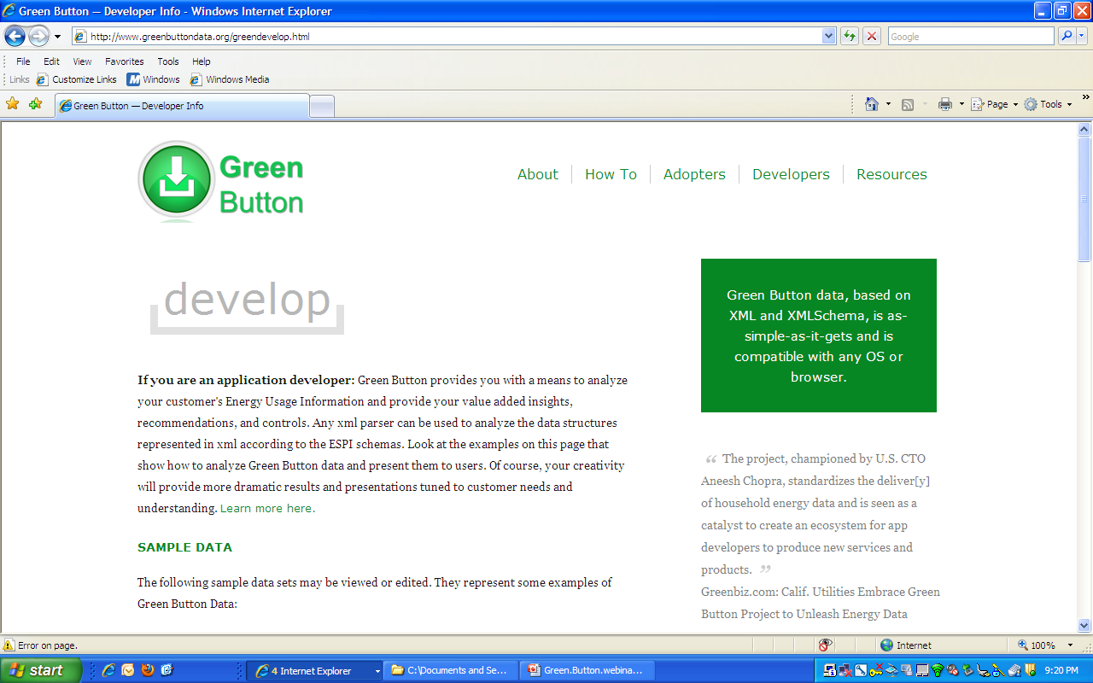
GreenButtonData – Live!!
www.greenbuttondata.org
Developer’s page: http://www.greenbuttondata.org/greendevelop.html

Slide 14
The Value Story
Why is this of interest to consumers
Energy Usage Information is feedback mechanism, knowledge is power
… to utilities
A well established specification will result in low cost of deployment of capabilities already planned and committed.
A single third party interface encourages value added services that don’t depend on continuous utility innovation on this interface.
… to regulators
Adoption of demand side management schemes will require consumer feedback and engagement to enable them to benefit. Many regulators are interested in ubiquitous low cost Green Button capabilities to enable consumer engagement and support return on investments.
… to implementers
A single interface allows robust applications to be developed
Focus on value added rather than multiple custom interfaces per utility
An ecosystem of goods and services built around concrete standard
Web applications
Desktop applications
Applications within the home: appliances, energy management systems, …

Slide 15




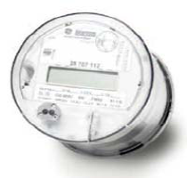
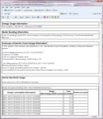


Consumer Perspective
What shall I do?
$
I now understand what I use and what it cost me.
I know what prices for use will be.
Third party value added services …
Here is what I used!
Here is what I’ll plan to use in future
How much did I use?

Slide 16
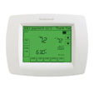
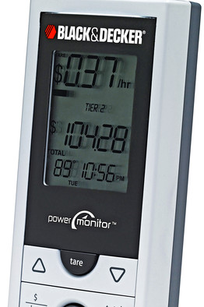
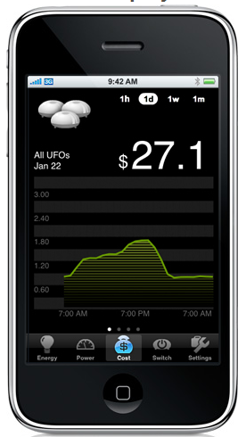
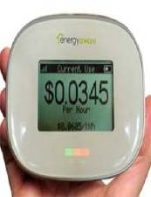

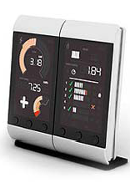
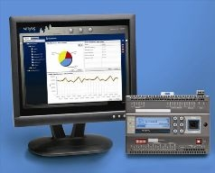
Green Button Enabling Vision
Usage Profile
Overall Usage
Cost of Usage

Slide 17
Green Button Time Line
Many companies pushing Utilities for proprietary 3rd party interfaces
2008
2009
2010
2011
2012
OpenADE TF formed
OpenADE Reqs PAP10
NAESB PAP10 Standard Ratified
ADE Concept Meeting
PAP10 in NIST SGIP CoS
Oracle
Microsoft
Google
Tendril
GreenBox
Control4
EnerNex
Xtensible
SCE
PG&E
Sempra
Oncor
Duke
Reliant
Consumers
Centerpoint
AEP
FPL
US CTO Green Button Initiative
NAESB ESPI Standard Ratified
CA IOUs Implement
Numerous additional implementations …

Slide 18
How SGIP Inspired Green Button Format
PAP10 was formed at the start of the SGIP to facilitate the standardization of Energy Usage Information
Resulted in NAESB (North American Energy Standards Board) REQ18/WEQ19 PAP10 EUI standard in December 2010
This was an information model standard, a “seed standard”, for other standards to use.
PAP10 EUI was taken up by NAESB REQ21 Energy Services Provider Interface
Based on UCAIug OpenADE and NAESB PAP10 standards
Ratified in October 2011
How to represent EUI in XML, and,
How to exchange it between utilities and third parties on behalf of consumers
Together these define a flexible file format for Green Button based on ratified standards from NAESB
The initial implementations of Green Button are narrowing in on a specific subset of ESPI and EUI for its realization

Slide 19
Which is Which
OpenADE: Requirements specification for secure delivery of historical and ongoing usage information to 3rd Party
PAP 10: Seed standard that defines a common energy usage information data model, for use across and interoperability between multiple standards
NAESB ESPI: Standard that satisfies the requirements laid out in OpenADE and incorporates the data model from NAESB PAP 10 Energy Usage Information
Green Button: File format subset of ESPI provides usage information to the consumer’s via Web site

Slide 20
What Drives Implementation
It was great to get Green Button off the mark with a quick demonstration of its capabilities, it is a bigger goal to support a sustained Green Button-infused ecosystem.
Keys:
Benefits drive adoption, barriers slow adoption
Therefore, minimize barriers to adoption
Three components to drive interoperability: Standards evolution, User Groups/Testing, Reference Implementations
SGIP engagement: Development of new Priority Action Plan (PAP20)

Slide 21
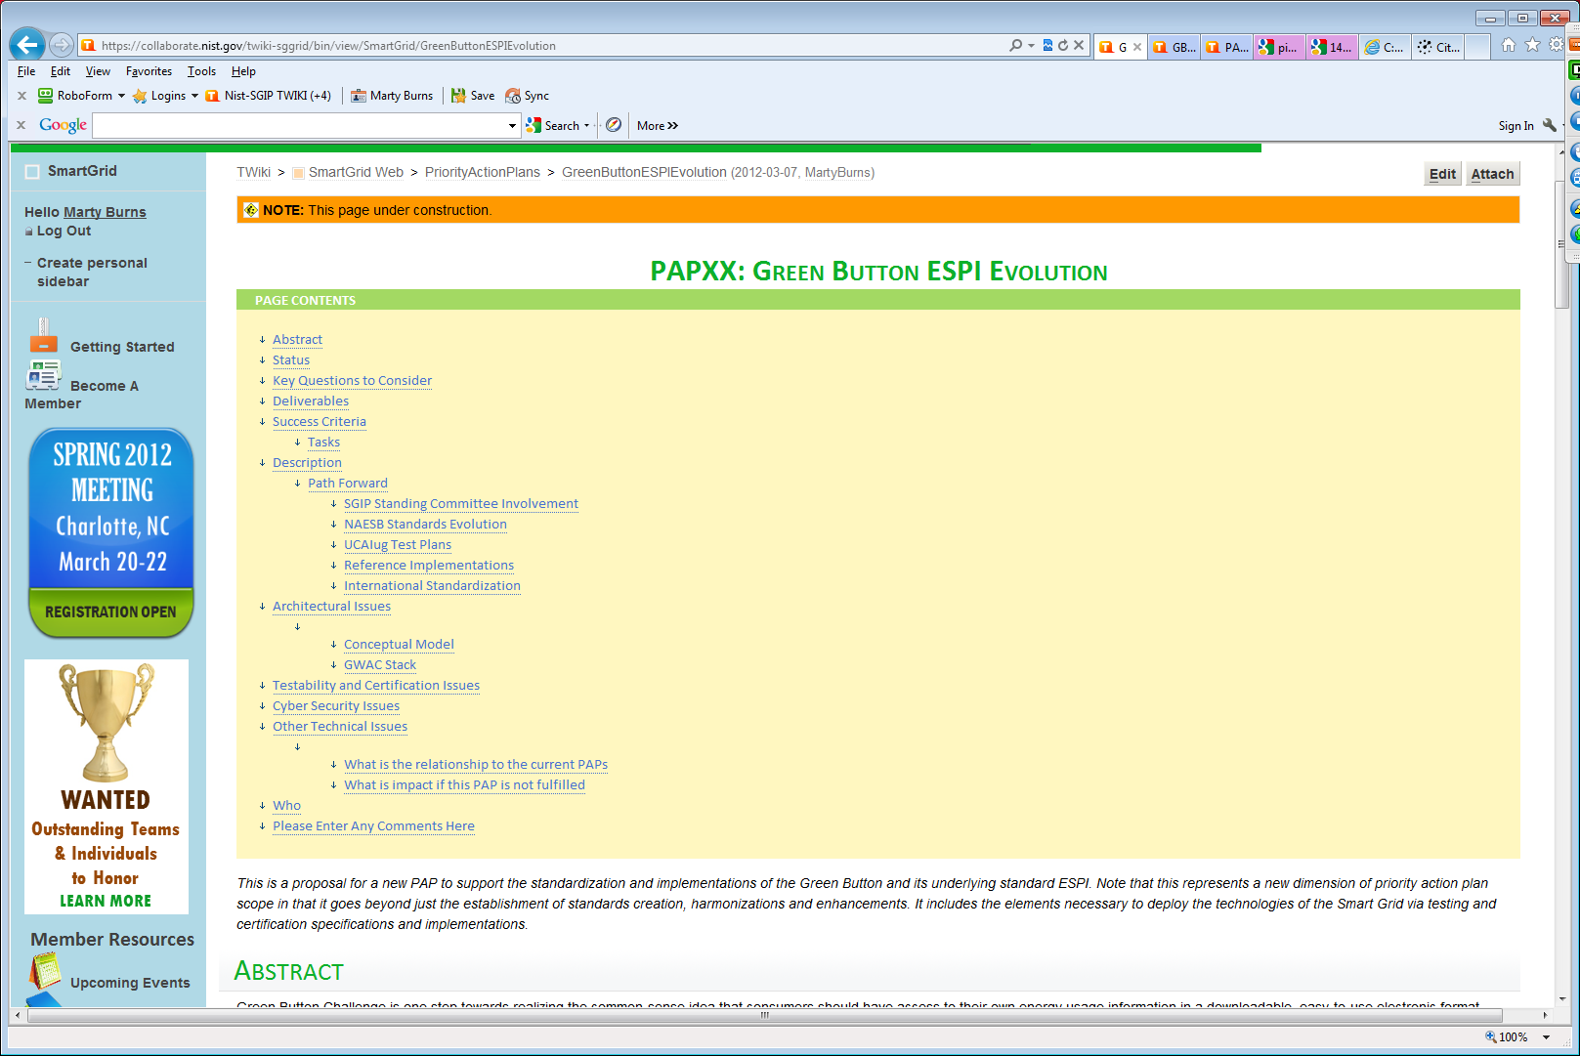
https://collaborate.nist.gov/twiki-sggrid/bin/view/SmartGrid/GreenButtonESPIEvolution

Slide 22
SGIP PAP20: Green Button ESPI Evolution
SGIP PAP Activities:
Coordinates with
PAP 20
CSWG
SGTCC
Requirements for Green Button and ESPI Rollout
Privacy assurance recommendations
Test plan consistency
Facilitate / Coordinate SGIP interactions
Cybersecurity recommendations for EUI exchanges
ITCA assurances
Specification Deliverables:
Where:
Standards (NAESB)
REQ18/WEQ19 Maintenance Update
ESPI Errata Update
ESPI New Reqs Update
International Version
T&C (UCAIug)
Green Button Test Plan
ESPI Test Plan
UCAIug ITCA
Implementation (EnergyOS)
Green Button SDK
OpenESPI
Implementation activities not formal part of PAP
Timeline:
2Q12
3Q12
4Q12

Slide 23
About the deliverables of PAP20 *planned dates to be confirmed at initial PAP20 meetings
SGIP Standing Committee Involvement
CSWG – Cyber Security and Privacy recommendations for ESPI exchanges
SGTCC – ITCA formation and test plan development collaboration
NAESB Standards Evolution
PAP10 Maintenance Update ~4/2012
ESPI Errata ~4/2012
ESPI Evolution ~9/2012
UCAIug Test Plans and ITCA (Interoperability Testing/Certification Authority)
UCAIug ITCA ~6/2012
Green Button Test Plan ~6/2012
ESPI Test Plan ~6/2012
Reference Implementations (these activities are not officially part of PAP)
Green Button SDK evolution ~6/2012
OpenESPI implementation and Test Harness ~6/2012
International Standardization
Seek International venue to cross-publish NAESB ESPI standard ~TBD
ESPI is profile (with extensions) of IEC 61968-9 2nd Edition

Slide 24
How to Reduce Barriers to Penetration
Standards
Users Groups
Interoperable products and services
Reference Implementations
Implementation agreements
Labeling and Test Certifications
Open Source Running Code
“golden unit”
Consensus among stakeholders
Maintenance and evolution
Issues resolution
Development projects
Barriers Impede Penetration of New Technology
NAESB
Activation
Energy
Potential
Energy
Benefits Drive Penetration of New Technology
Green Button as Catalyst Speeds Penetration
UCAIug
OpenESPI

Slide 25
Green Button Technical Details
David Wollman, NIST
With acknowledgements to Marty Burns of the EnerNex SGIP administrator team

Slide 26
What is the constellation of development tools and collaboration environments
Composition of Green Button Data
Green Button SDK
OpenESPI, an open-source ESPI implementation
UCAIug Test Plans

Slide 27
Composition of Energy Usage Information
EUI comes from and to residences and businesses
UsagePoint
ServiceCategory
MeterReading
IntervalBlock
ElectricPowerSummary
IntervalReading
ReadingType
ElectricPowerQuality Summary
ReadingQuality
Note: This information is multidimensional. Many different reading types, summaries, and readings possible. i.e. not “flat”

Slide 28
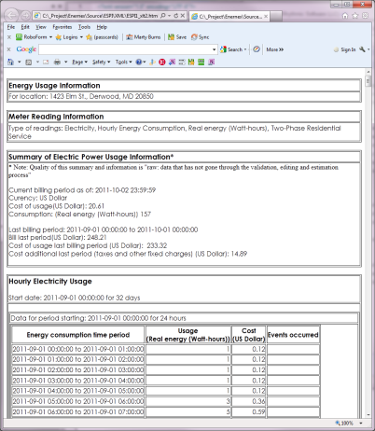
Diversity of information in EUI
Measurements of power, energy, gas, water, …
Quality: Raw, validated, estimated, …
Source: Meter near real-time, utility back end, third party
Economics: Consumers need to know the cost of their consumed power (but we did not construct a pricing model)
Identification: by customer, device, location
Dimensions
Kinds of Data
Readings
Interval data
Summary Information
Power Quality Metrics

Slide 29
Some examples of Green Button Data
Hourly load profile for past billing period plus current period to date
Fifteen minute load profile for most recent 15 days
Daily load profile for past month or year
Summary only data
Energy usage and energy demand readings
Gas, Water usage profiles
Yearly summary data with monthly parts

Slide 30
Green Button SDK
GETBatchSampleEUI.xml: Sample Green Button EUI File
ESPIRender_xslt1.xslt: XSLT Rendering Style Sheet
Green Button Data Generator Spreadsheet: Available for download from OpenESPI on GitHub
espi.xsd, atom.xsd: schemas constrain xml documents
NAESB Green Button Portal - http://www.naesb.org/ESPI_Standards.asp
To purchase the NAESB ESPI Standard on which the Green Button file format is based, use the following link: http://www.naesb.org/misc/naesb_matl_order_espi_standards.pdf
http://www.GreenButtonData.org

Slide 31
Tools that are currently available and how they work
WC3 standard components – xsd, xslt, xml
OpenESPI development environment
Development Virtual Machine
Graphics

Slide 32

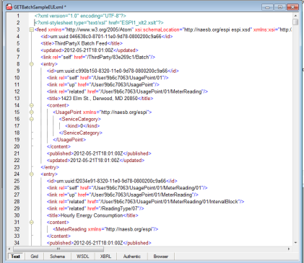
Web Technologies for Definition and Presentation of EUI File Format
X
XML Schema (XSD)
XML
XSLT
Describes the rules of file format
Contains customer EUI data in standard file format and references to XSD and XSLT
Defines how to transform for humans
Standard EUI file Format

Slide 33
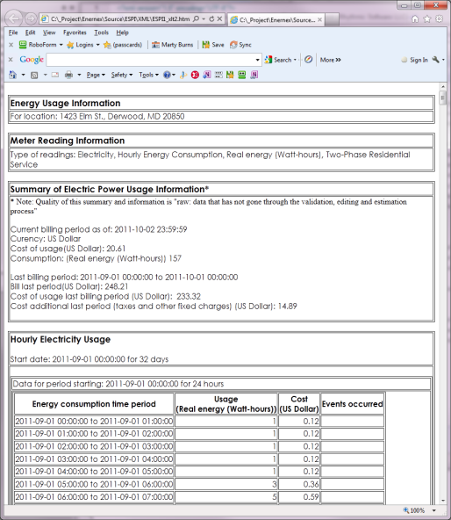
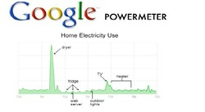
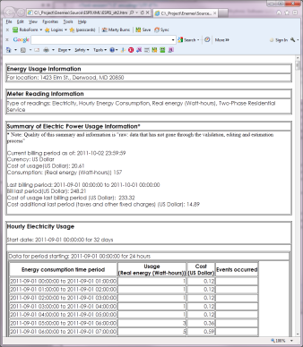


Alternate paths to EUI – single format
Sources of EUI
Single Data Format: all at once
Uses of EUI
Power Utility
Via: ESPI, SEP2, Web Portal
Single Data Format: as sequence
Acknowledgements to graphics owners

Slide 34
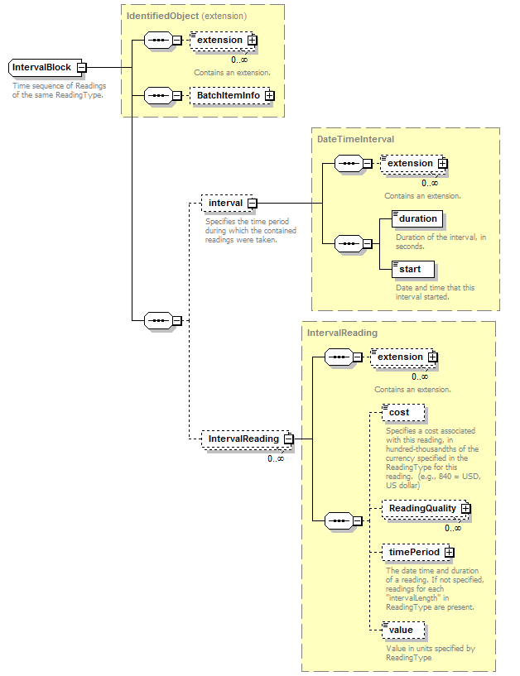
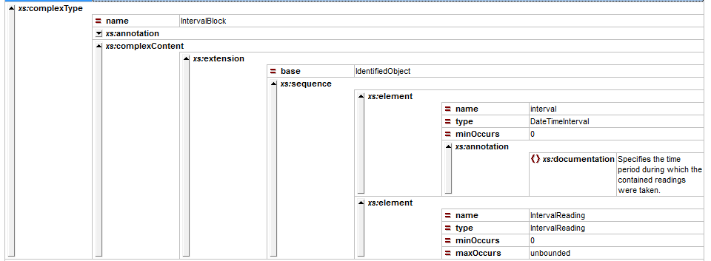
Green Button Schemas: Views in XMLSpy™
“colored text”
“graphic view”
“grid view”

Slide 35
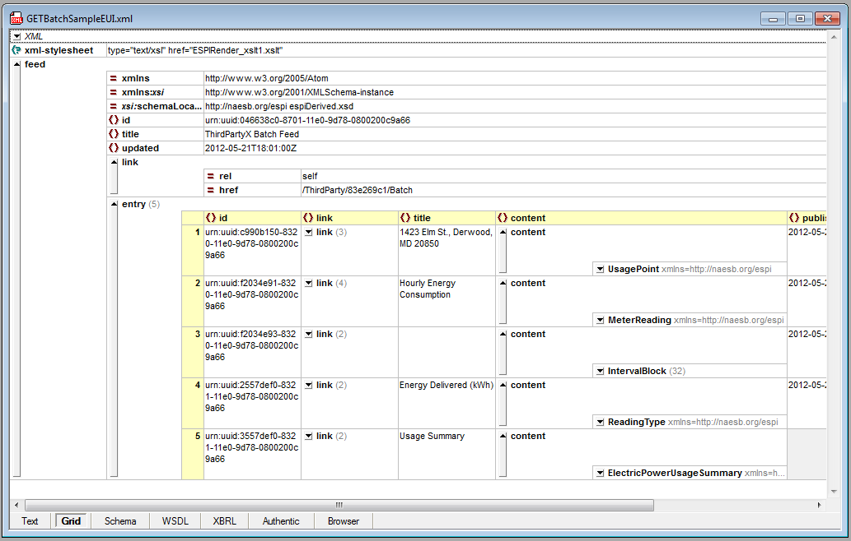
Green Button Data XML File
UsagePoint
MeterReading
IntervalBlock
IntervalBlock
ReadingType
ElectricPower UsageSummary

Slide 36
Green Button Schemas: IntervalBlock
IntervalBlock has an Interval time definition
The IntervalReadings have values, cost, and reading quality, as well as optional time period
Note: most parts of schema can be extended

Slide 37
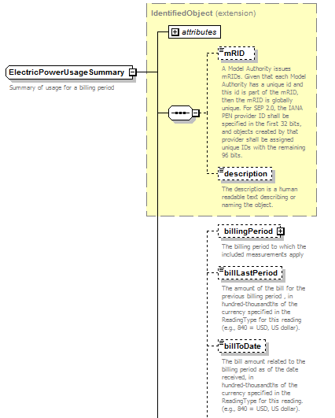
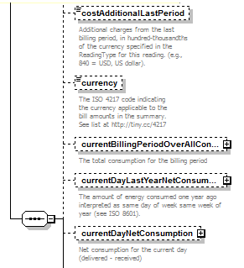
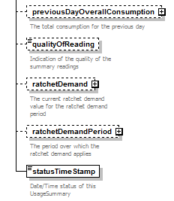
Green Button Schemas: ElectricPowerUsageSummary

Slide 38
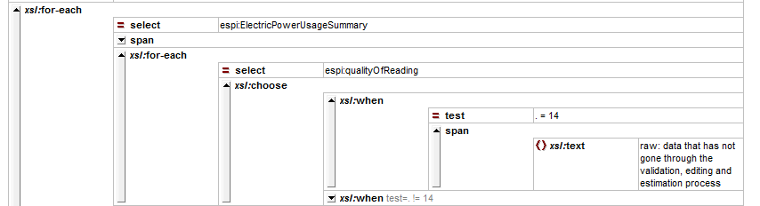
Green Button Sample XSLT
XSLT
XML
HTML

Slide 39
Binding Green Button File to XSLT and XSD
Identify XSLT Style Sheet
Identify XSD Schema Location

Slide 40
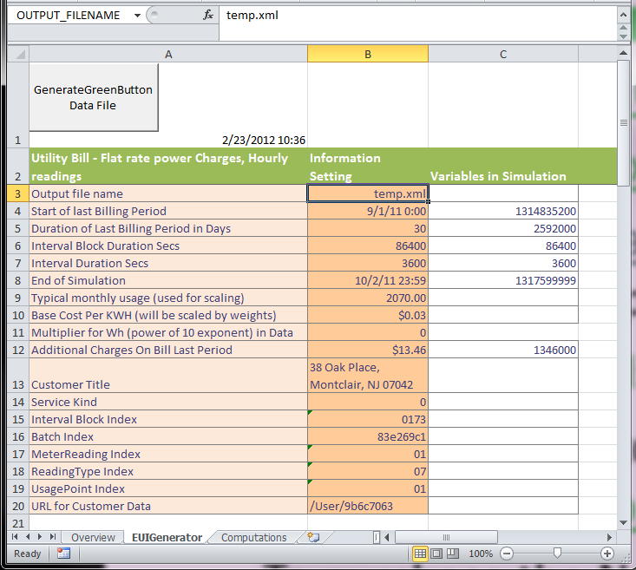
Green Button Data File Generator
Set the structure of the intervals and blocks
Set weightings for weekdays and weekends

Slide 41
OpenESPI Software Architecture
Actors:
Consumer
Data Custodian
EnergyServiceProvider
InformationElements:
Representations
EUI Data Repository
UseCases/Sequences:
Scenario Automatons
OAuth/AtomPub Patterns
Orchestration and Deployment
Frameworks:
Spring Model/View/Controler
Spring Social (OAuth)
Apache Wink (AtomPub)
Development Platform:
Eclipse Projects
Ubuntu VM
Java Builds
C++ Builds (future)
Testing Plans:
JUnit + Spring Testing Framework
Selenium Automations

Slide 42
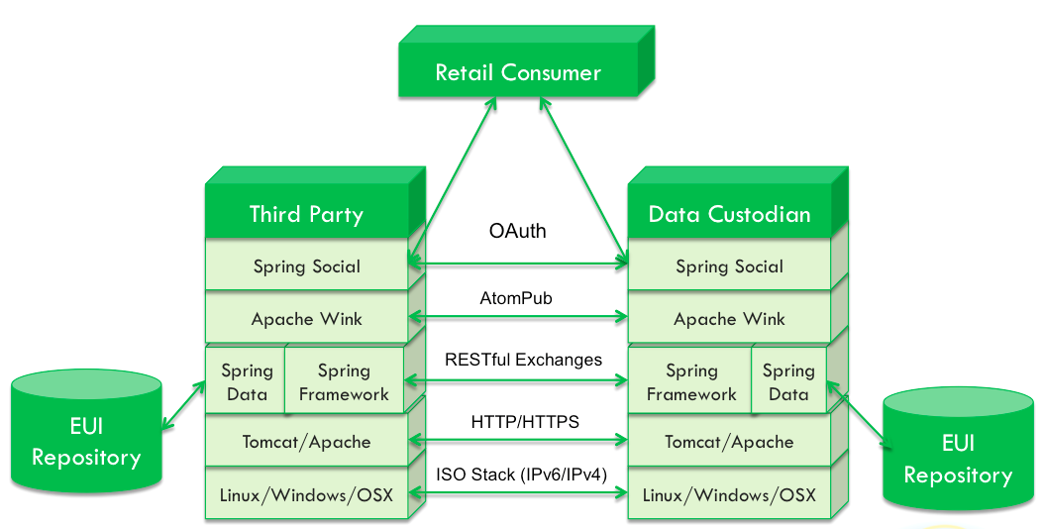
OpenESPI Frameworks – Spring Profile

Slide 43
Virtual Machine for OpenESPI Development
The OpenESPI Development Virtual Machine is a Linux Ubuntu desktop environment that may be used to jumpstart your OpenESPI development efforts. Further background on the VM may be found at http://www.openespi.org/vm.html
The VM connects to the GitHub remote repository
All Development Tools, Web Servers, and Test Tools are Incorporated into Free VM
VM Player for Windows is Free
VM Player for Apple is ~$50

Slide 44



Green Button Graphics*
Green Button Download
My Data
* With permission of Veterans Administration (Blue Button) through “comfort letter”

Slide 45
Discussion about tools and testing going forward
Where work is occurring
Acceleration project for testing tools
User community to support
A Policy
A Brand
What Green Button is
End user applications
A Collection of technologies
Technical standards, test plans and certifications
How to contribute
How to comment/discuss

Slide 46
How Open Source Can Work With Business Goals
Funding
Administration
Funders
Consulting / Development Group
Funders
UCAIug
Funders
Funders
OpenADE Task Force
Requirements
SW Development
OpenESPI / Green Button Apache Licensed Open Source Development Project
Open Source
Commercial Products ESPI Implementations
Commercial Products Certification Test Tools
Commercial Products Certifications
Commercial $$ Products and Services

Slide 47
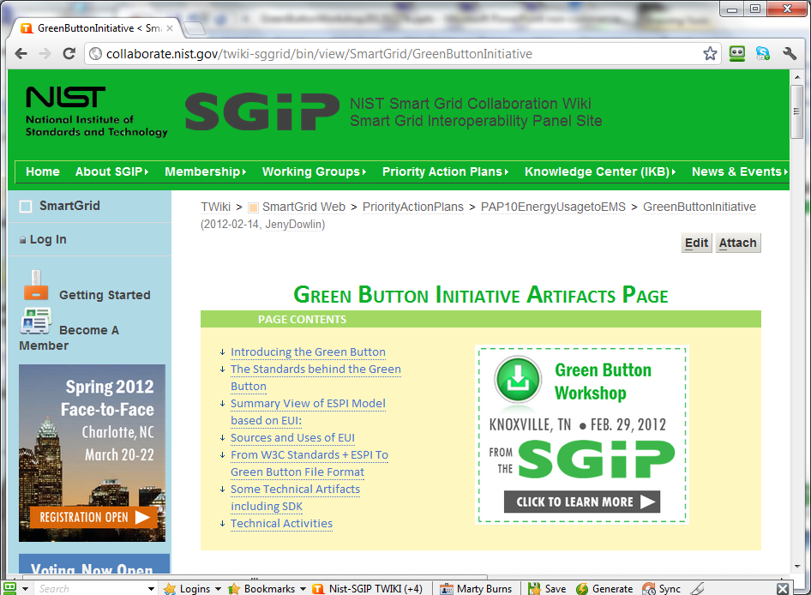
http://collaborate.nist.gov/twiki-sggrid/bin/view/SmartGrid/GreenButtonInitiative

Slide 48
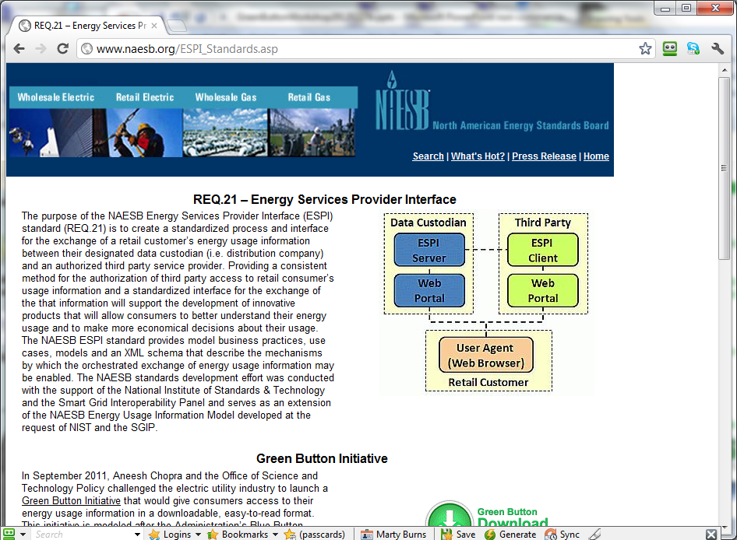
http://www.naesb.org/ESPI_Standards.asp

Slide 49
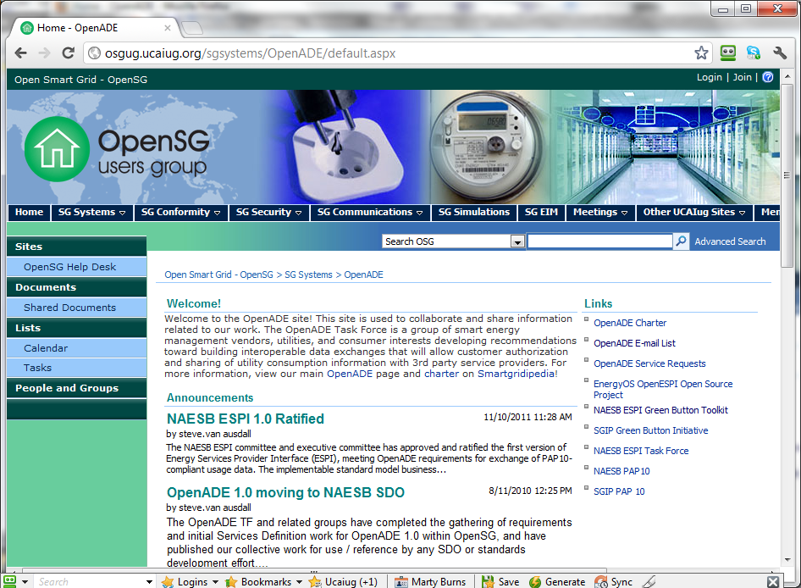
http://osgug.ucaiug.org/sgsystems/OpenADE/default.aspx

Slide 50
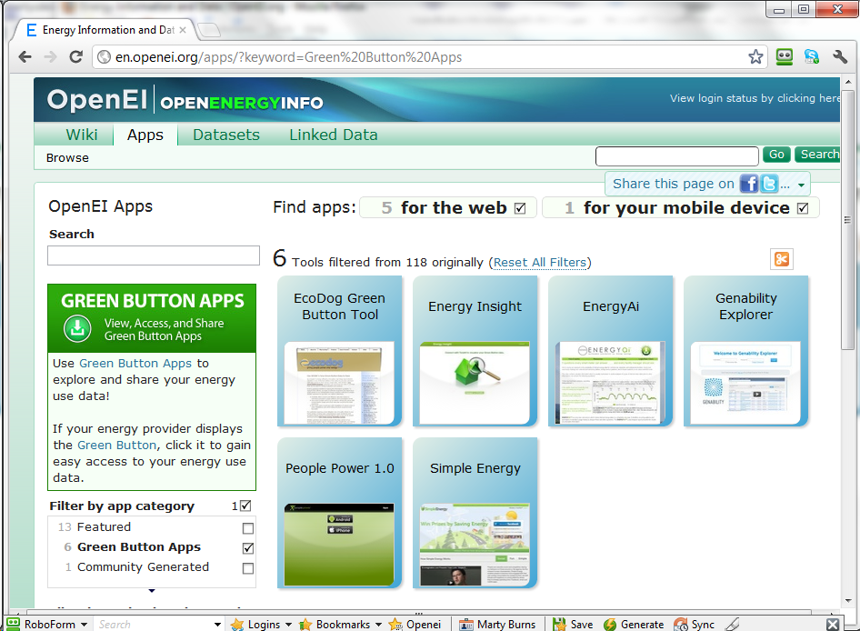
http://openei.org
Green Button Apps

Slide 51
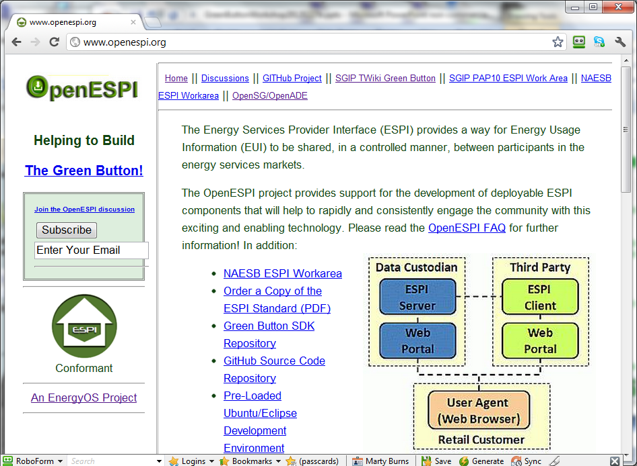
http://www.openespi.org/

Slide 52
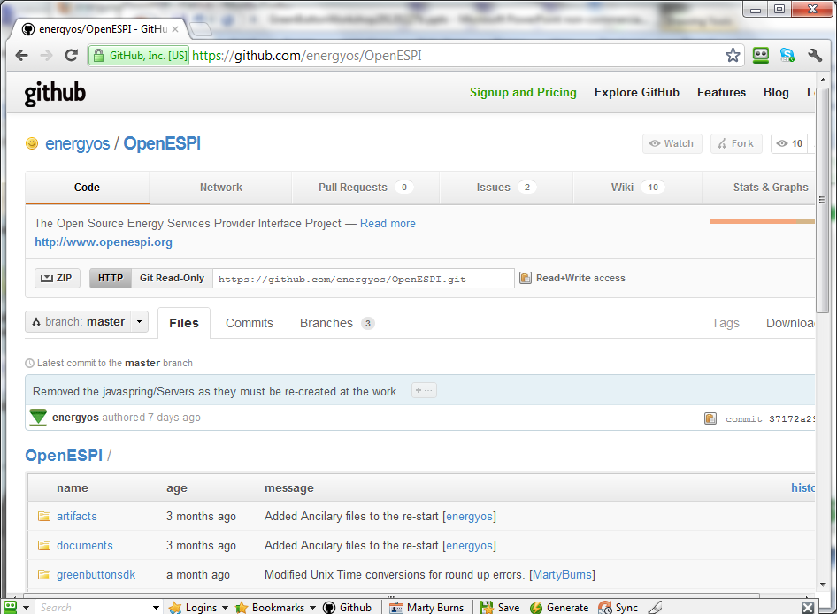
https://github.com/energyos/OpenESPI

Slide 53
Issues Resolution
Related to NAESB Standards, Test Plans, Branding of Green Button:
http://osgug.ucaiug.org/HelpDesk/Lists/servicerequests/GreenButton.aspx
Related to Development Tools, Open Source, Implementation of Test
https://github.com/energyos/OpenESPI/issues

Slide 54
Links
NAESB
NAESB PAP10 Task Force Project Page : http://www.naesb.org/smart_grid_pap10.asp
NAESB ESPI Task Force Project Page : http://www.naesb.org/espi_task_force.asp
NAESB ESPI and PAP10 email lists: to subscribe contact Denise Rager at NAESB - drager@naesb.org
NAESB Green Button Portal - http://www.naesb.org/ESPI_Standards.asp
UCAIug
UCAIug OpenADE Mail List: http://www.smartgridlistserv.org/cgi/wa.exe?A0=OPENSG-OPENADE
UCAIug OpenADE Meetings: tuesdays at 3:00 EST - https://www2.gotomeeting.com/join/844935738, 415-363-0070 #844-935-738
UCAIug OpenADE Green Button Issues List: http://osgug.ucaiug.org/HelpDesk/Lists/servicerequests/GreenButton.aspx
EnergyOS
EnergyOS OpenESPI Mail List: http://groups.google.com/group/energyos_espi/subscribe?hl=en
EnergyOS OpenESPI Web Site: http://www.openespi.org/
EnergyOS OpenESPI Meetings: mondays at 12:00 EST - https://www2.gotomeeting.com/join/129392235, +1 (516) 453-0010 #129-392-235
EnergyOS OpenESPI GitHub: https://github.com/energyos/OpenESPI
EnergyOS OpenESPI GitHub Issues List: https://github.com/energyos/OpenESPI/issues
NREL OpenEnergyInfo Green Button Apps Repository: http://en.openei.org/wiki/Main_Page
Green Button Data Web Site: http://www.greenbuttondata.org

